Slide 1
Neural Network Backpropagation

Slide 2
Derivatives - The Rate of Change

Slide 3
Derivatives - The Rate of Change

Slide 4
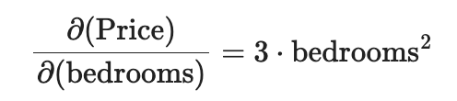
Derivatives - The Rate of Change
How much does the Price change given a change in bedrooms?

Slide 5
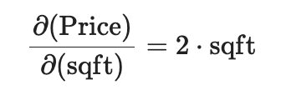
Derivatives - The Rate of Change
How much does the Price change given a change in bedrooms?
How much does the Price change given a change in area (sqft)?

Slide 6
Loan Amount | Credit Score | Debt-to-income Ratio | Default (y)
5000 | 700 | 0.3 | 0
20000 | 650 | 0.5 | 1
10000 | 750 | 0.2 | 0
15000 | 600 | 0.6 | 1
8000 | 720 | 0.25 | 0

Slide 7
Loan Amount
Credit Score
Debt-to-income Ratio

Slide 8


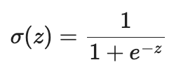





Loan Amount
Credit Score
Debt-to-income Ratio

Slide 9
Derivatives

Slide 10
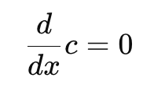

Slide 11
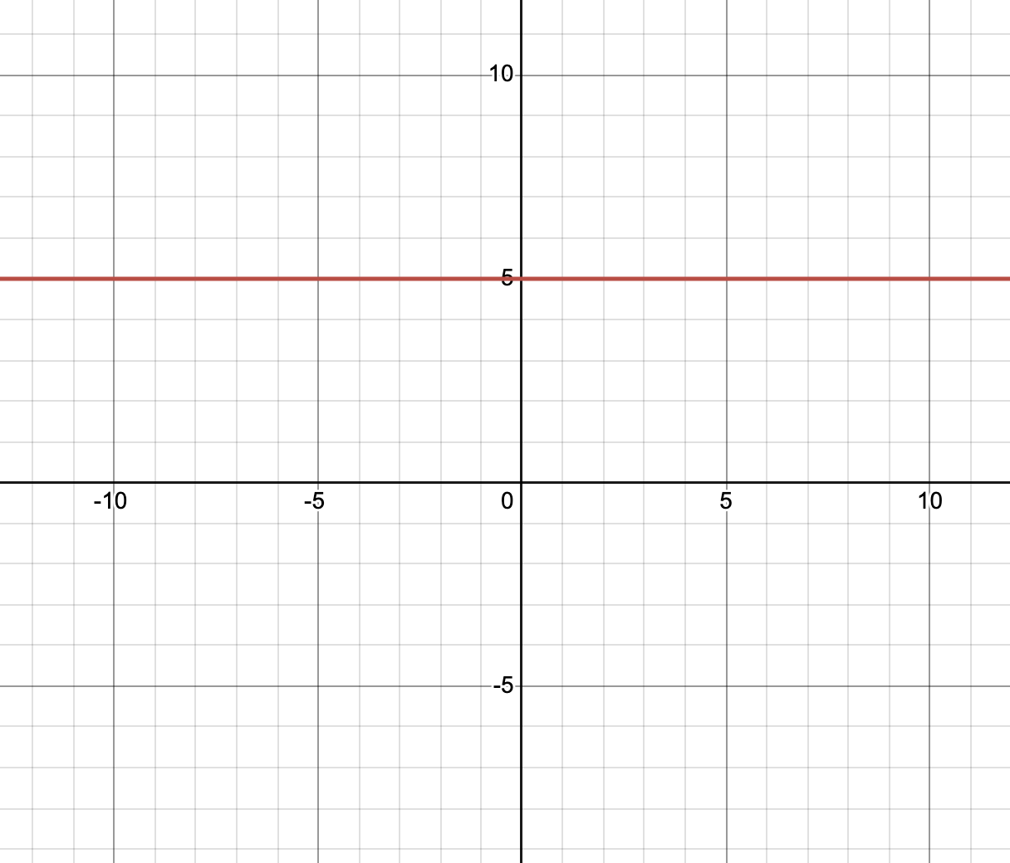


Slide 12
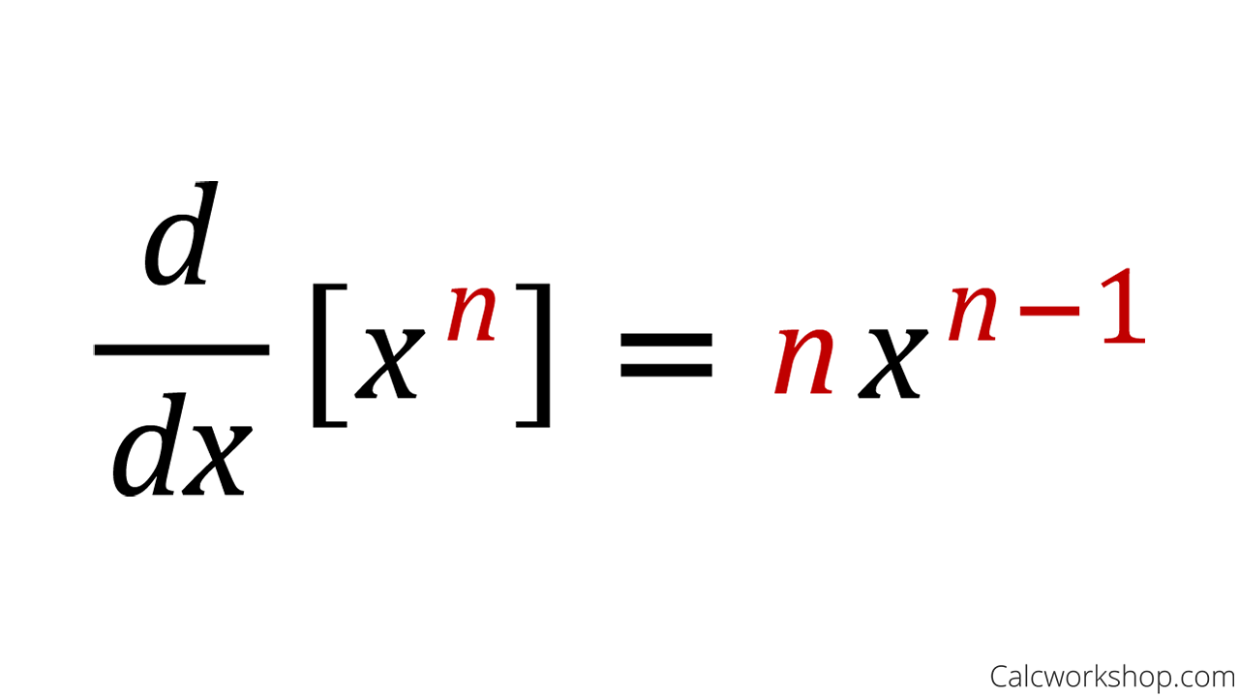
The Power Rule

Slide 13
Derivatives - The Rate of Change
How much does the Price change given a change in bedrooms?
How much does the Price change given a change in area (sqft)?

Slide 14

The derivative of f(x) = ?

Slide 15


Slide 16
The Chain Rule

Slide 17



Nested Functions
?

Slide 18
Nested Functions

Slide 19
Nested Functions
Derivatives

Slide 20


Nested Functions

Slide 21
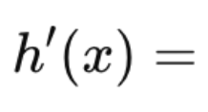
Nested Functions
?

Slide 22

Nested Functions

Slide 23

Nested Functions

Slide 24
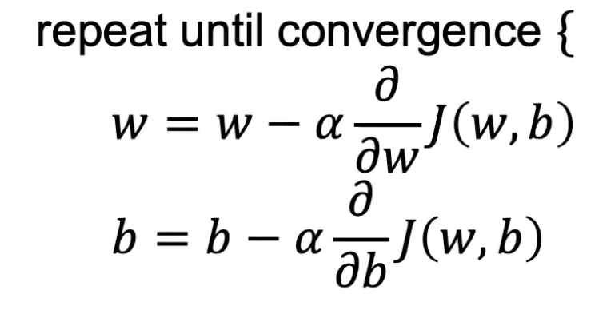
The Gradient Descent Algorithm

Slide 25
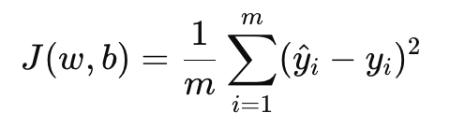
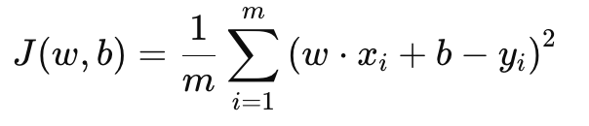
2
2

Slide 26
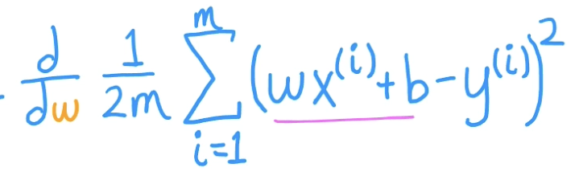
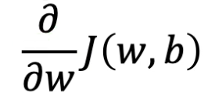
=

Slide 27
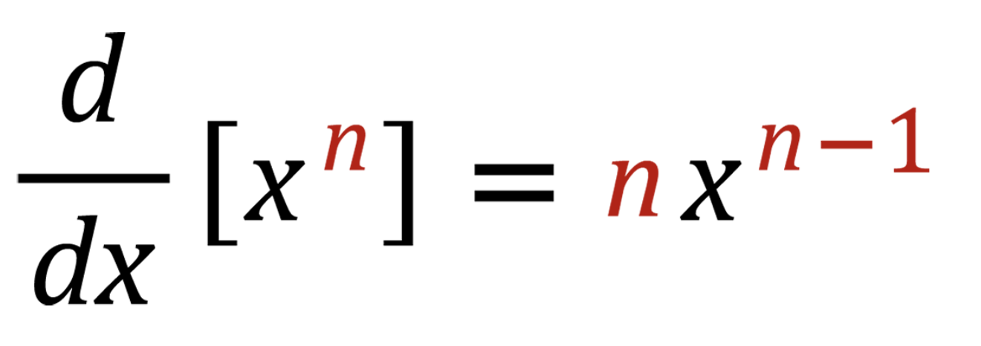
=

Slide 28
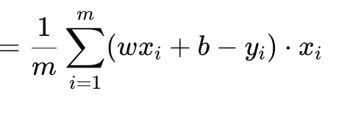
=
2
2

Slide 29
=
2
2

Slide 30
=

Slide 31
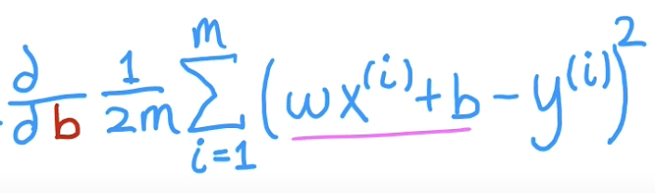
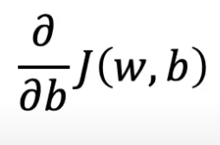
=

Slide 32
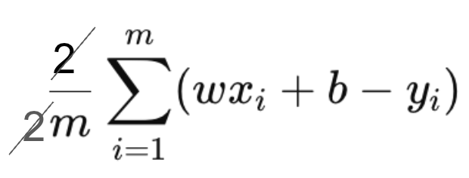
=

Slide 33
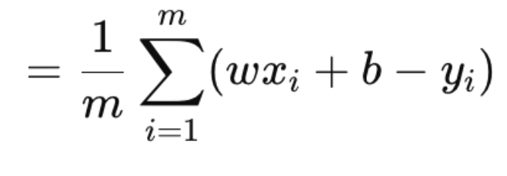
=

Slide 34
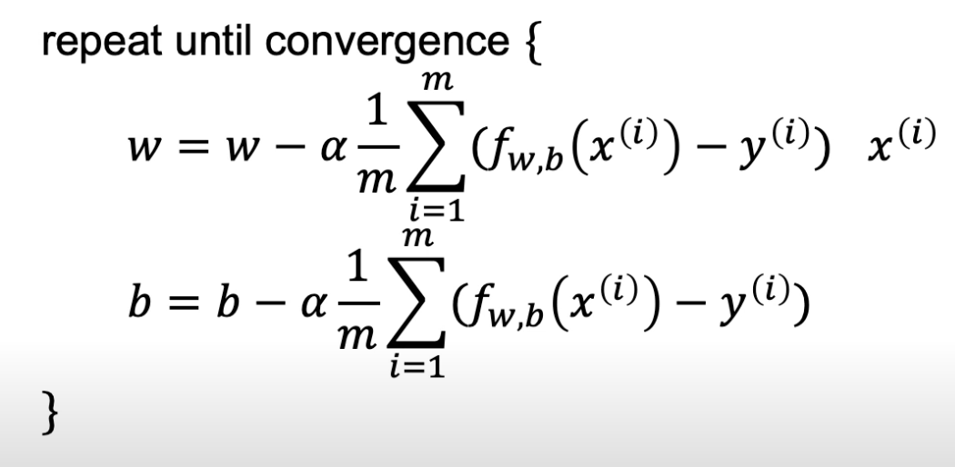

Slide 35
Backpropagation How the Neural Network Learns

Slide 36
Backpropagation
The chain rule helps us compute the gradient (derivative) of the loss function with respect to each weight, especially when there are multiple layers in the neural network

Slide 37
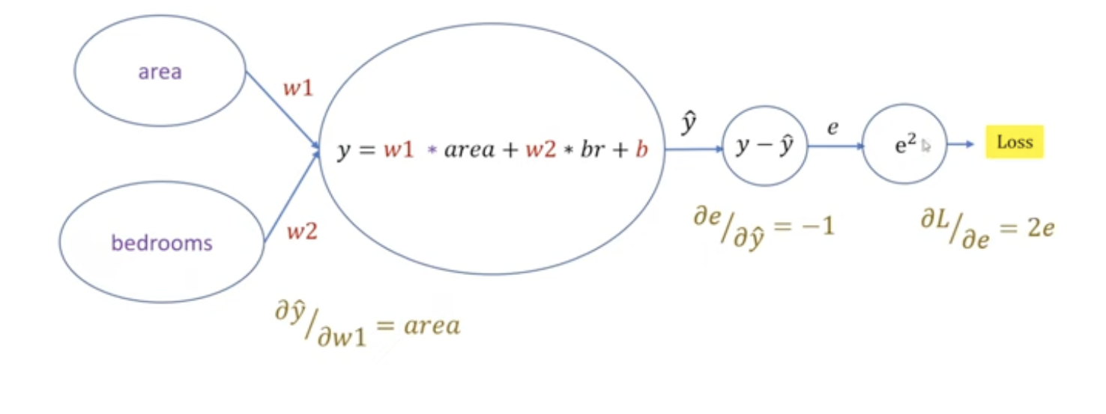
The Chain Rule

Slide 38
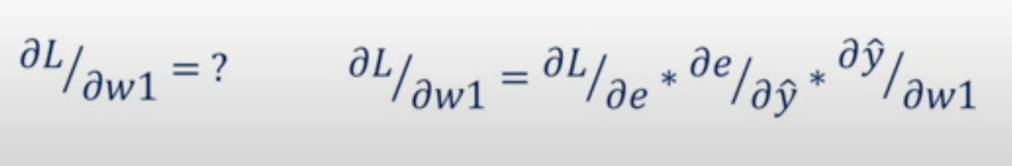
The Chain Rule

Slide 39
Loan Amount
Credit Score
Debt-to-income Ratio
= L

Slide 40
Now, to minimize the loss, we need to adjust the weights. To know how to update the weights, we need to compute how much each weight contributed to the error. This is where backpropagation comes in

Slide 41
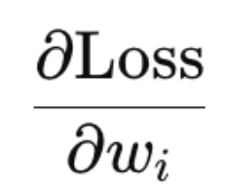
Now, to minimize the loss, we need to adjust the weights. To know how to update the weights, we need to compute how much each weight contributed to the error. This is where backpropagation comes in

Slide 42
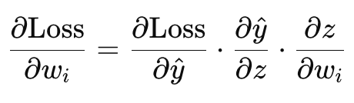
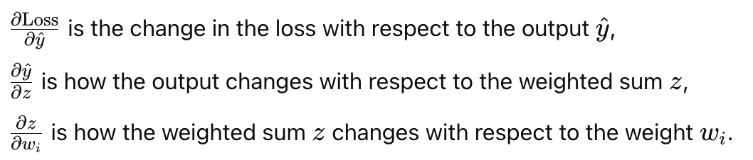

Slide 44
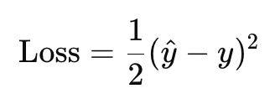
Step 1:

Slide 45
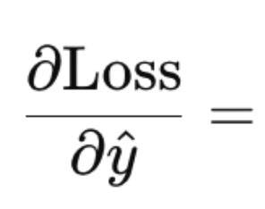
Step 1:

Slide 46
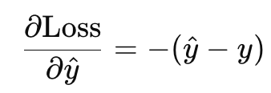
Step 1:

Slide 48
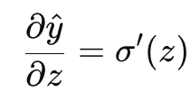
Step 2:

Slide 49
Step 2:

Slide 50



Slide 51
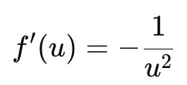


Slide 52
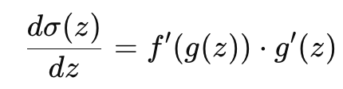

Slide 53
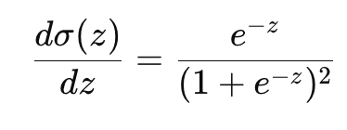

Slide 54
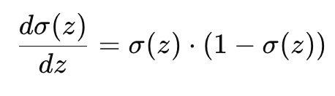
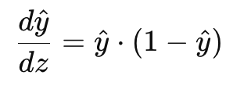
OR

Slide 55
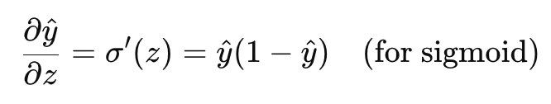
Step 2:

Slide 57

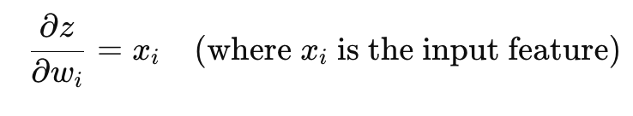

Step 3: Compute the gradient of z with respect to the weight
?

Slide 58
Compute the gradient of z with respect to the weight

Slide 59
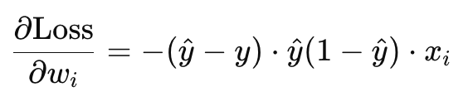
Combining Them All

Slide 60
The Intuition
Forward pass: Compute the output based on the inputs and weights.
Compute loss: Calculate how far off the prediction is from the true value.
Backward pass: Using the chain rule, propagate the error backward through the network, calculating how each weight affects the loss.
Update weights: Adjust the weights using the computed gradients to minimize the error

Slide 61
